Slide 1

Cancer Genomics Unplugged:
Investigating Gene Expressions in Depth

Slide 2

01 Introduction
05 Volcano Plots
02
Investigating Gene Expressions
TABLE OF CONTENTS
06
GSEA
03 Hypothesis Testing
07 Conclusion
04 Fold Change

Slide 3

INTRODUCTION
cancer genomics, a field of study that delves into the genetic intricacies of cancer.
With the aim of unraveling the mysteries behind this complex disease, researchers have identified gene expression as a main area of focus.
In our project, we specifically concentrate on lung cancer, exploring the unique genetic signatures and alterations that drive these malignancies.

Slide 4

02 Investigating Gene Expressions

Slide 5

Hypothesis Testing
Fold CHange
Volcano PLots
DEGs Analysis
01
02
03

Slide 6
Why FDR?
01
Data Preprocessing
Loaded GE for normal & cancerous tissues
Stored data in a dictionary with genes as keys and GE levels as values
Handling null values by removing genes having over 50% zero values
02
Normality Testing
Assessed the normality of lung datasets using Shapiro-Wilk test, segregating genes into normal and non-normal distributions.
Hypothesis Testing
03
Statistical Testing
In Case of Paired Samples
Applied Wilcoxon Signed-Rank test to evaluate the significance of GE between normal and cancerous tissues
In Case of Independent Samples
Applied Wilcoxon Rank-Sum test
04
False Discovery rate Correction [FDR]
Applied FDR correction to reduce false positives [Type I Errors]
05
Identifying DEGs
We compared the resultant P-Values to the alpha values to infer the DEGs

Slide 7

Extracting Dataset
Paired Samples
Independent Samples
Wilk-Shapiro
Normality Test
Wilk-Shapiro
Normality Test
Block Diagram
NO
NO
YES
YES
t-test
Wilcoxon Signed-Rank Test
Wilcoxon Rank-Sum Test
Wilch Test
t-test
FDR Correction
P-value < 0.05
P-value ≥ 0.05
DEGs
Not DEGs

Slide 8
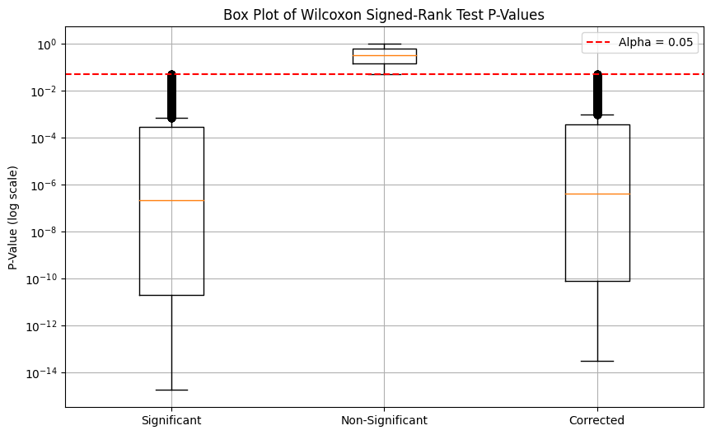
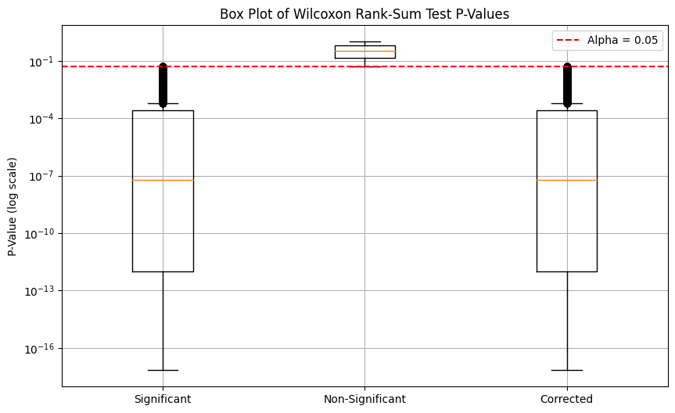
Total Filtered Genes
17284
13432
Paired DEGs
13377
Independent DEGs

Slide 9
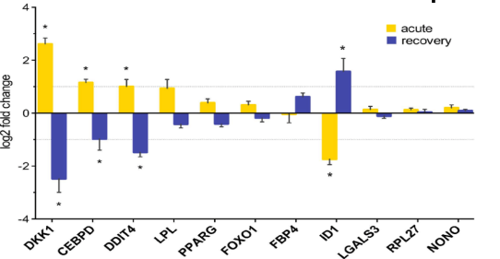
Fold Change A measure indicating how much GE levels changes between two conditions or groups which is considered a key metric for identifying differentially expressed genes.
We used a log2 FC threshold of 2 for significance.
The addition of epsilon (ε) to both normal and cancerous expression levels before calculating the log2 fold change is critical to prevent infinite or undefined values in the log2 transformation.
Fold Change
FC = log2(Cancerous Levels / Normal Levels)

Slide 10
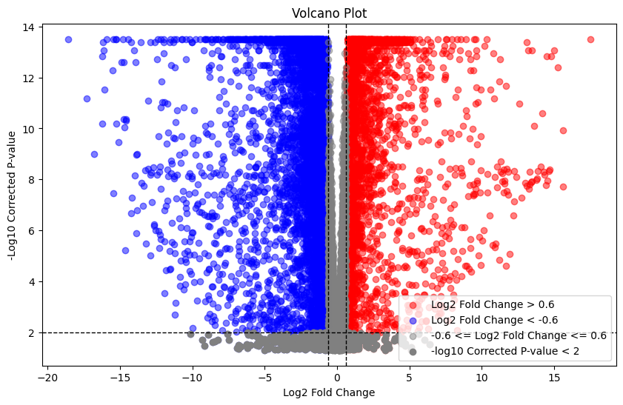
Relationship between statistical significance and fold change for each variable in a dataset, with significant features appearing at the plot's extremes.
Volcano Plots

Slide 11
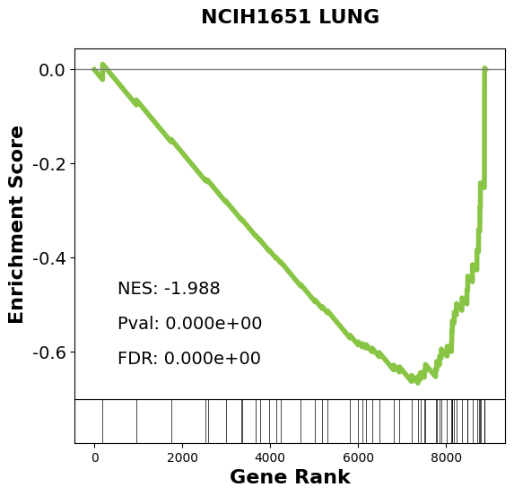
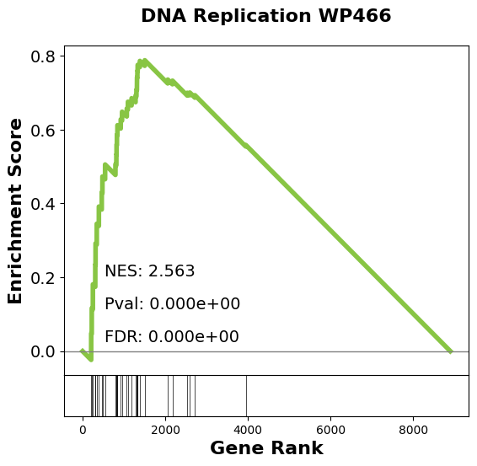
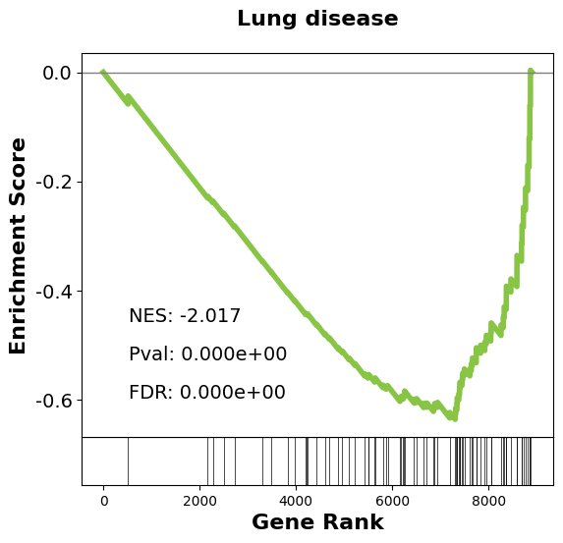
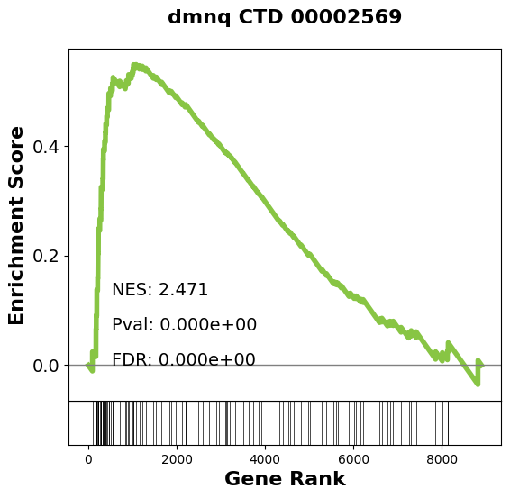
Ranking = -np.log10(Corrected P-value) * (Log2 Fold Change)
Followed Steps
Acquired a csv file from FC, Corrected P-Value and gene.
Calculated ranking.
Sorting the outcome using the ranking column in descending order.
GSEA

Slide 12
Our Team
THANKS!
Yassmin Sayed
Raghda Tarek Neiazy
Does anyone have any questions?

